Slide 1
Streamlit & Heroku
- By Hardik Raja

Slide 2
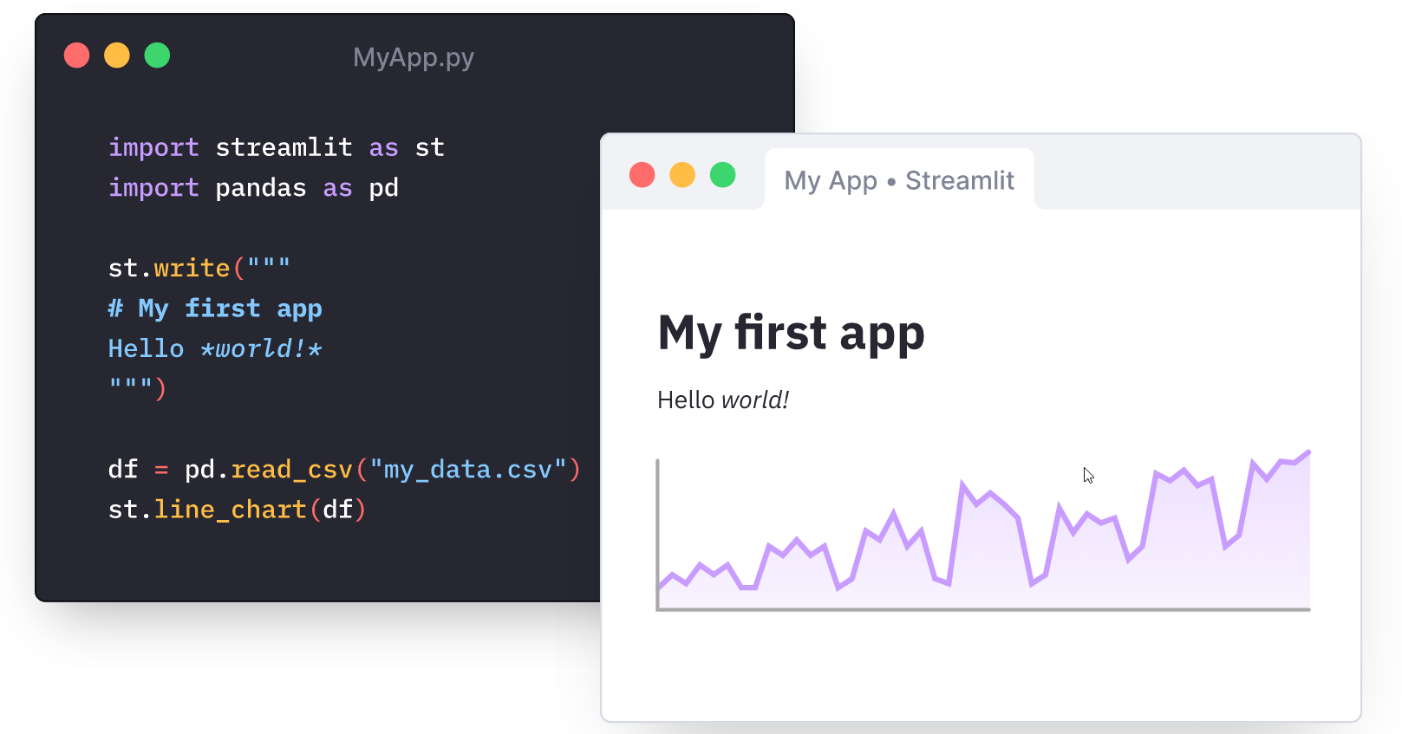
Introduction to Streamlit
Fastest way to build and share data apps
Turns data scripts into shareable web apps in minutes
All in Python. All for free. No front‑end experience required
Builds upon three simple principles
Embrace scripting
Build an app in a few lines of code with their simple API. Also see it automatically update as you iteratively save the source file.

Slide 3
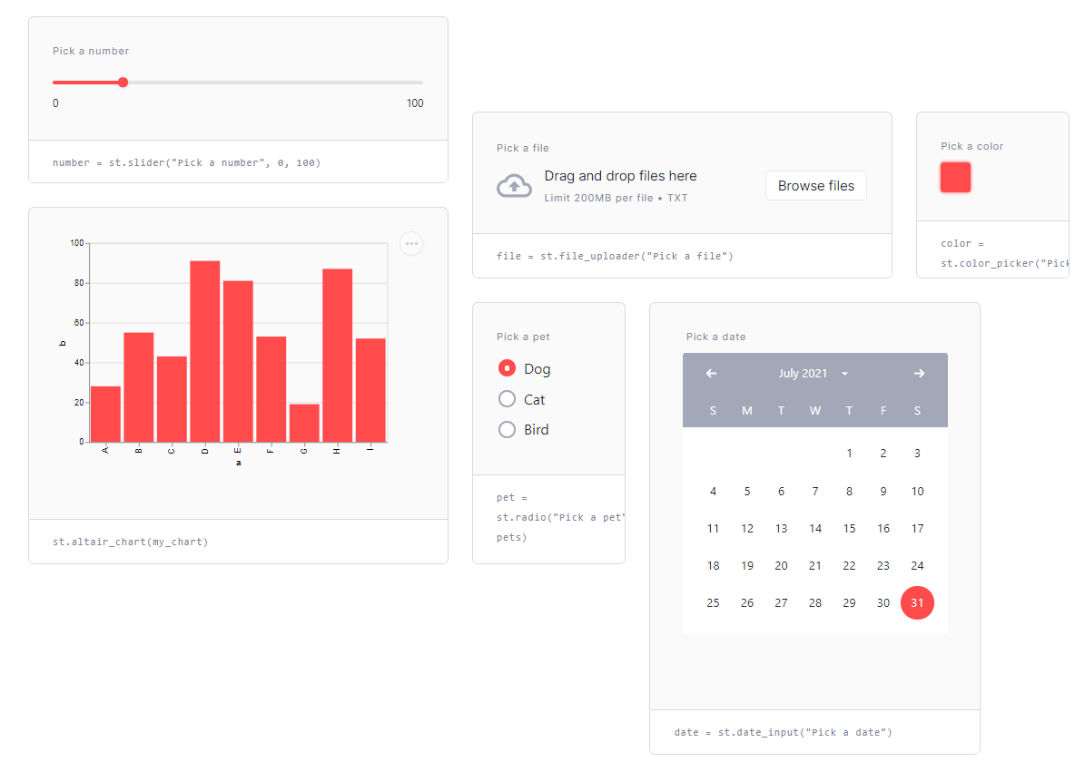
Streamlit Principles
2. Weave in interaction
Adding a widget is the same as declaring a variable. No need to write a backend, define routes, handle HTTP requests, connect a frontend, write HTML, CSS, JavaScript etc.

Slide 4
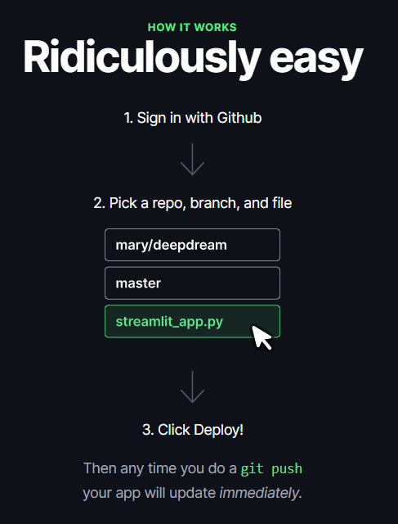
Streamlit Principles
3. Deploy instantly
Use Streamlit’s invite-only sharing feature to effortlessly share, manage,
and collaborate on your apps.

Slide 5
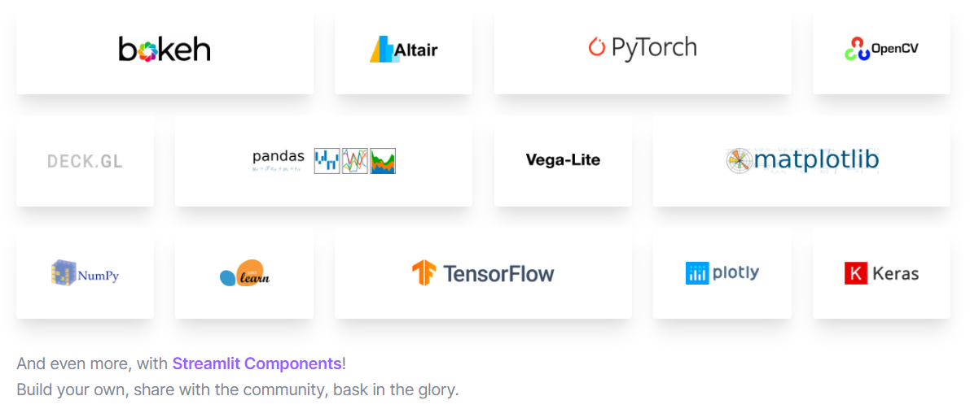

Compatibility
Compatible with

Slide 6
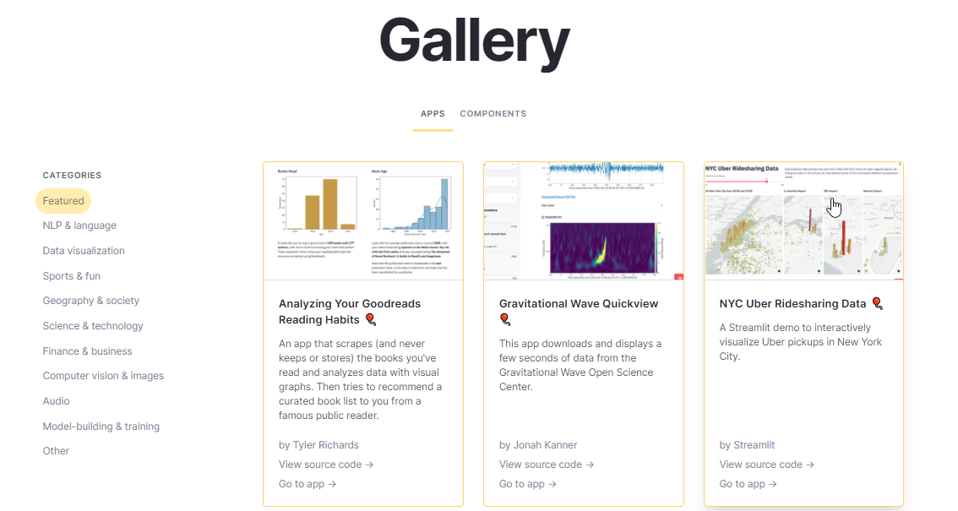
Gallery for further examples
Link - https://streamlit.io/gallery

Slide 7
Other Similar products
Dash - Similar to Streamlit; But Streamlit is more easy to use
H2o Wave - Its not as mature as compared to Streamlit

Slide 8
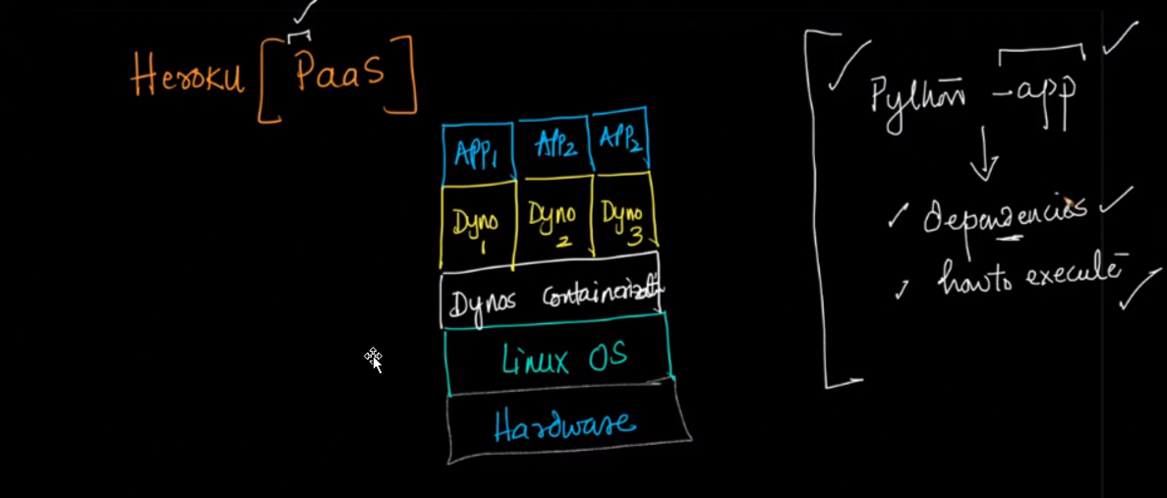

Heroku
Dynos – It is the containerization technology used in Heroku; Like Docker

Slide 9
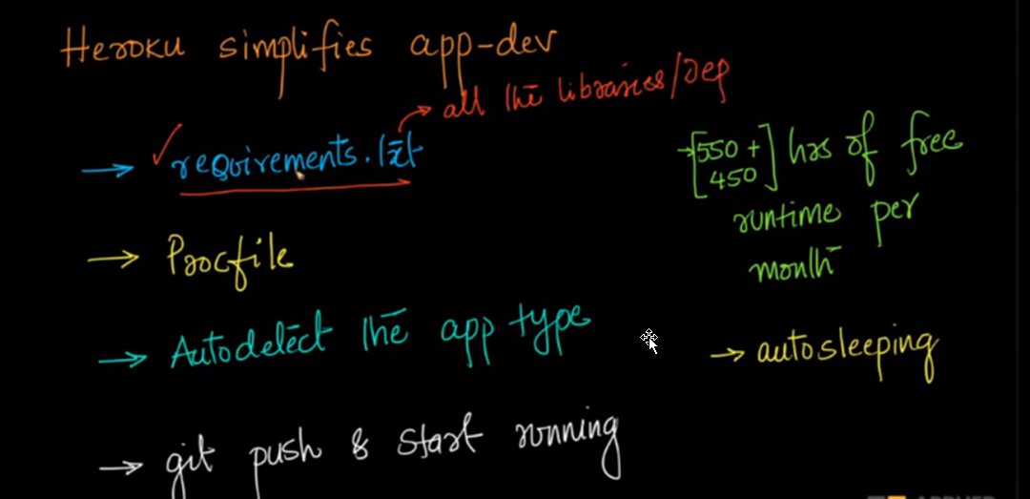
Heroku
Heroku is designed to showcase fast prototypes/ A single DS to showcase his work

Slide 10
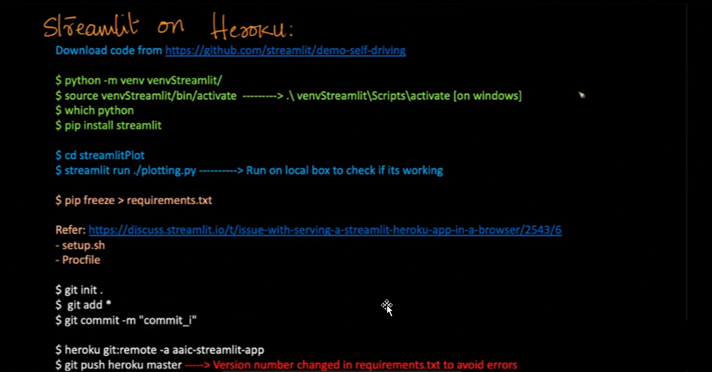
Heroku
Slug is a compressed and pre-packaged form of python app (Along with all dependencies specified via req.txt and procfile) specific to Heroku

Slide 11
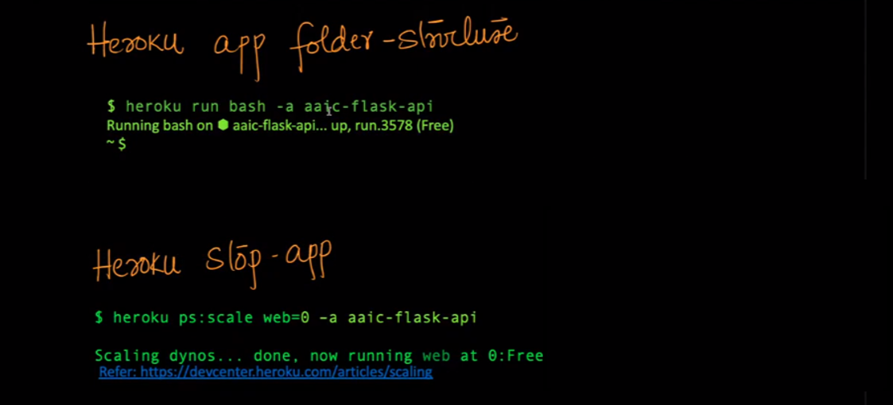
Heroku

Slide 12
Demo & Questions
Demo at
https://judgement-prediction-streamlit.herokuapp.com/
and
Questions ??

